Slide 1
IoT BASED AIR QUALITY MONITORING SYSTEM USING WEBPAGE
BY:
PUSAPALLY SRINIVAS
J BELSHA JACKLINE PRINCESS
LUPTAVISHA NETAM
CHILUKA SAI CHAITANYA

Slide 2
AIM
To find out the air quality index at a particular place or industry by Interfacing ESP32 and GAS SENSOR(MQ135).

Slide 3
COMPONENTS USED
ESP32 MICROCONTROLLER
GAS SENSOR MQ135
ARDUINO UNO 1.8.5 VERSION SOFTWARE
JUMPER CABLES

Slide 4
INTRODUCTION
Continuous exposure to environment with poor air quality is a major public health concern in developed and developing countries.
It is estimated that the pollutants responsible for poor air quality causes nearly 2.5 million permature deaths per year .
Significantly around 1.5 million of these deaths are due to polluted indoor air .

Slide 5
OVERVIEW
This project provides a combination of process of sensing several gas levels in the atmosphere.
The levels of the gases are displayed though a LED .
Which continuously gives the real time output values of gas sensor through ThingsSpeak and in WEBPAGE

Slide 6
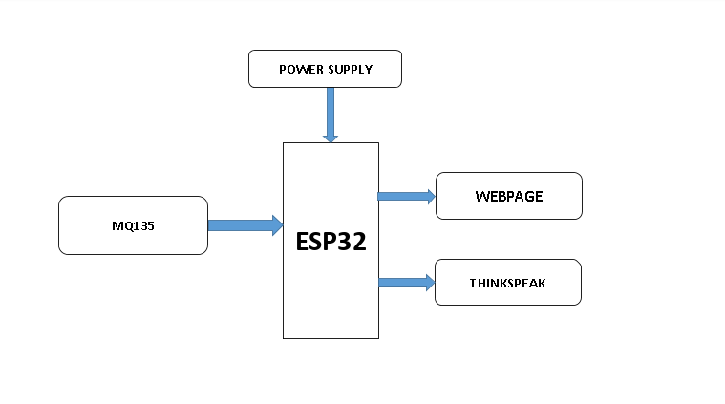
Block diagram

Slide 7
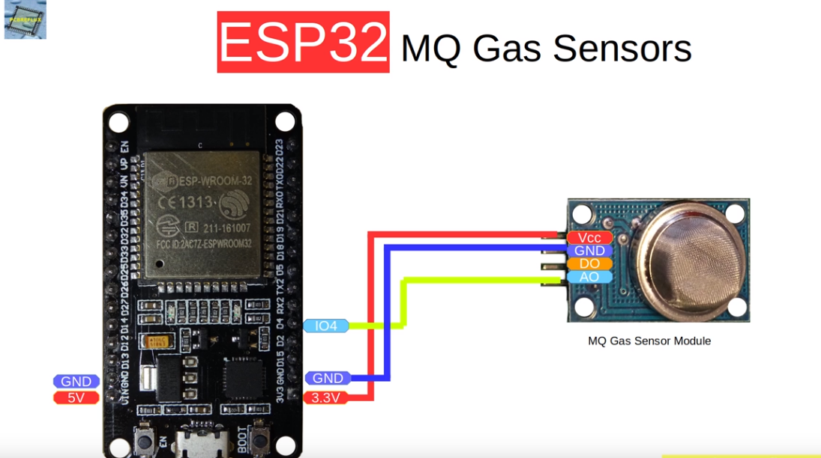
Circuit diagram

Slide 8
Circuit and explanation
First of all we will connect the ESP32 with the Arduino. ESP32 runs on 3.3V and if you will give it 5V from the Arduino then it won’t work properly and it may get damage. Connect the VCC and the CH_PD to the 3.3V pin of Arduino. The RX pin of ESP32 works on 3.3V and it will not communicate with the Arduino when we will connect it directly to the Arduino. So, we will have to make a voltage divider for it which will convert the 5V into 3.3V. This can be done by connecting three resistors in series like we did in the circuit. Connect the TX pin of the ESP32 to the pin 10 of the Arduino and the RX pin of the esp8266 to the pin 9 of Arduino through the resistors.
ESP32Wi-Fi module gives your projects access to Wi-Fi or internet. It is a very cheap device and make your projects very powerful. It can communicate with any microcontroller and it is the most leading devices in the IOT platform. Learn more about using ESP32 with Arduino here.
Then we will connect the MQ135 sensor with the Arduino. Connect the VCC and the ground pin of the sensor to the 5V and ground of the Arduino and the Analog pin of sensor to the A0 of the Arduino.

Slide 9
PROGRAM
#include <WiFi.h>
#include <WiFiClient.h>
#include <WiFiServer.h>
#include <WiFiUdp.h>
#include <ThingSpeak.h>
const char* ssid = "SmartBridge";
const char* password = "smartbridge@sb";
WiFiClient client;
unsigned long myChannelNumber = 805724;
const char * myWriteAPIKey = "JFQLRDW7YOO6FV02";

Slide 10
void setup()
{
Serial.begin(115200);
delay(10);
// Connect to WiFi network
Serial.println();
Serial.println();
Serial.print("Connecting to ");
Serial.println(ssid);
WiFi.begin(ssid, password);
while (WiFi.status() != WL_CONNECTED)
{
delay(500);
Serial.print(".");
}
Serial.println("");
Serial.println("WiFi connected");
// Print the IP address
Serial.println(WiFi.localIP());
ThingSpeak.begin(client);
}

Slide 11
void loop()
{
static boolean data_state = false;
for (int i=0;i<=10;i++)
{
int temperature = i;
Serial.print("Temperature Value is :");
Serial.print(temperature);
// Write to ThingSpeak. There are up to 8 fields in a channel, allowing you to store up to 8 different
// pieces of information in a channel. Here, we write to field 1.
ThingSpeak.writeField(myChannelNumber, 1, temperature, myWriteAPIKey);
delay(30000); // ThingSpeak will only accept updates every 15 seconds.
}
}

Slide 12
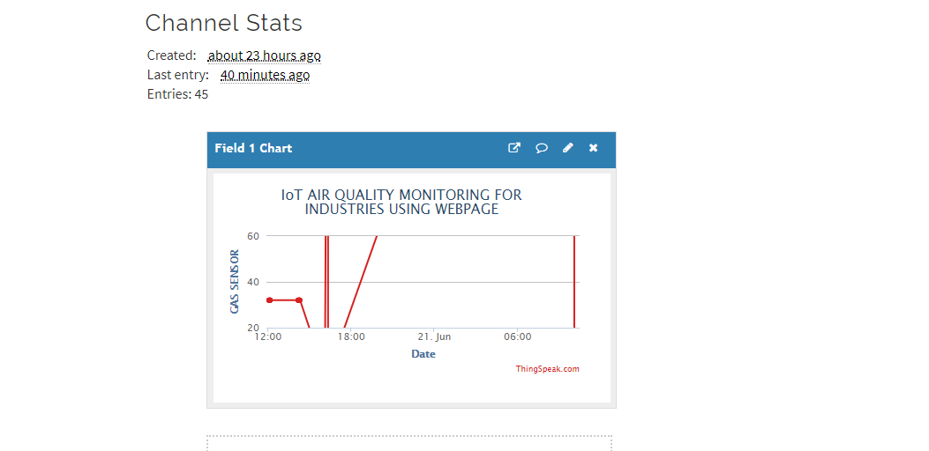
CHANNEL STATS IN ThingSpeak

Slide 13
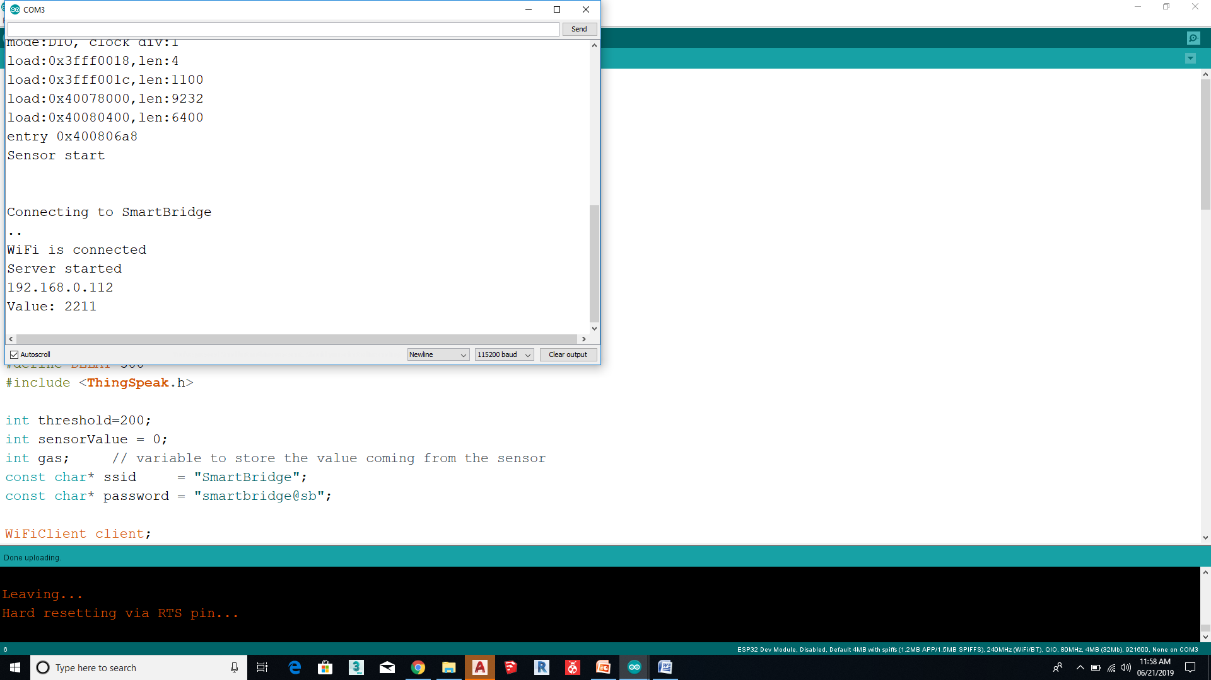
SERIAL MONITOR

Slide 14
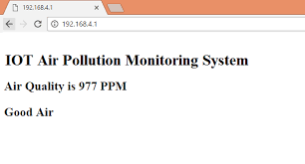
OUTPUT ON WEBPAGE

Slide 15
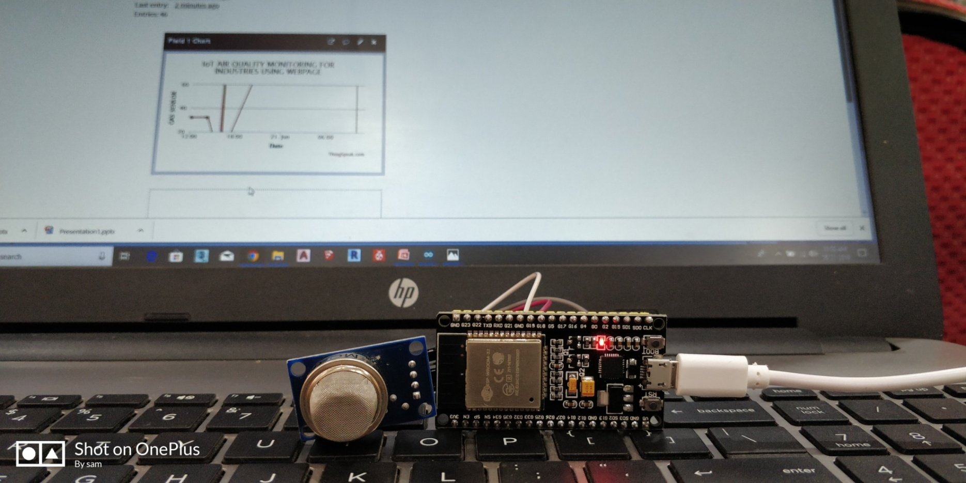
WORKING MODEL

Slide 16
APPLICATIONS
INDOOR AIR QUALITY MONITORING
INDUSTRIAL PERIMETER MONITORING
ROADSIDE POLLUTION MONITORING
TO MAKE THIS DATA AVAILABLE FOR COMMON MAN

